Slide 1
Review of the Myocardial Uncertainty Viewer (muView) Project
Paul Rosen
In collaboration with Brett Burton, Kristin Potter, and Chris Johnson

Slide 2
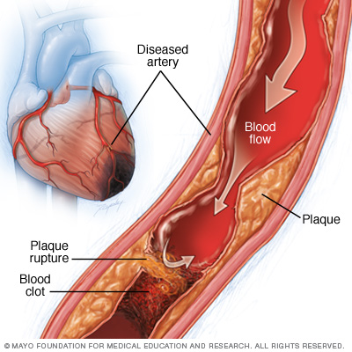
Clinical Problem Domain: Myocardial Ischemia
Reduced blood flow to heart muscle, reduced oxygen supply
Results in weakened muscle tissue
May also cause serious abnormal heart rhythms

Slide 3
Treatment: Improving blood flow to the heart muscle
Medications, open blocked arteries, coronary bypass, etc.
Full Treatment requires understanding
Geometry of damaged tissue
Effects on healthy tissue

Slide 4
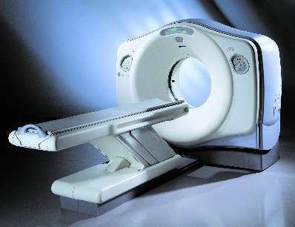
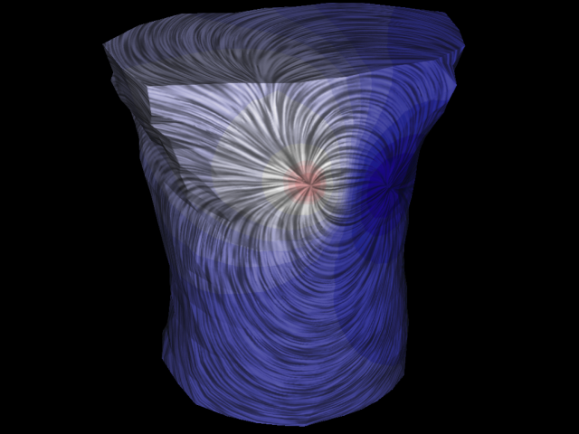
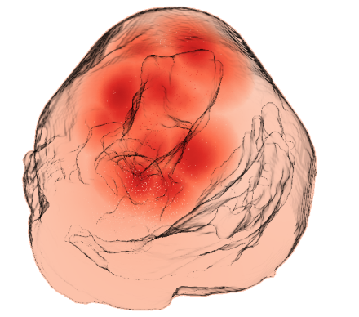
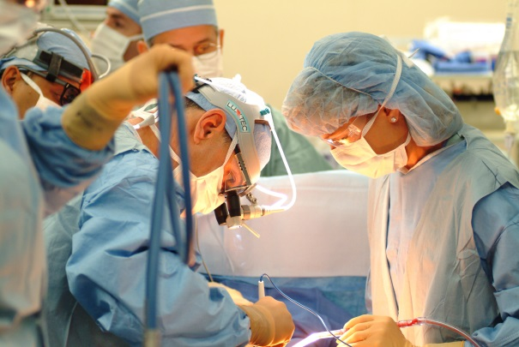
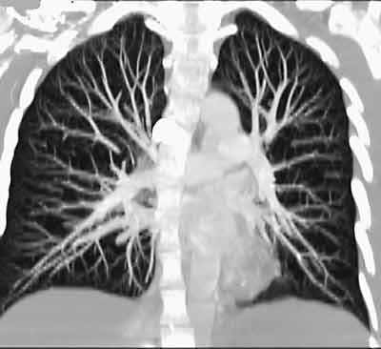
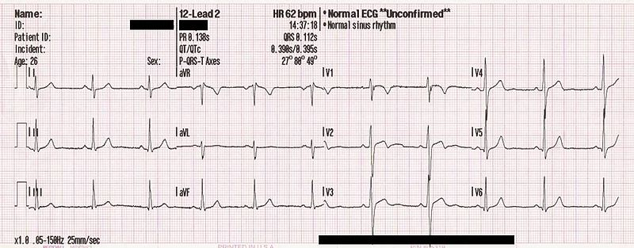
Big Picture Project
Diagnostic Testing
Simulation
Analysis
Treatment
impactscan.org
radiologyinfo.org
thinkquest.org
wikipedia.org

Slide 5
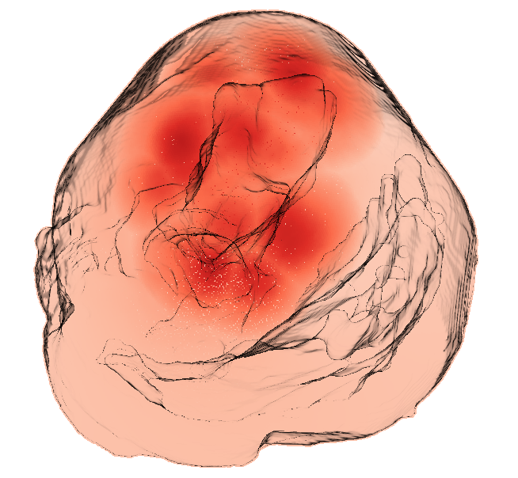
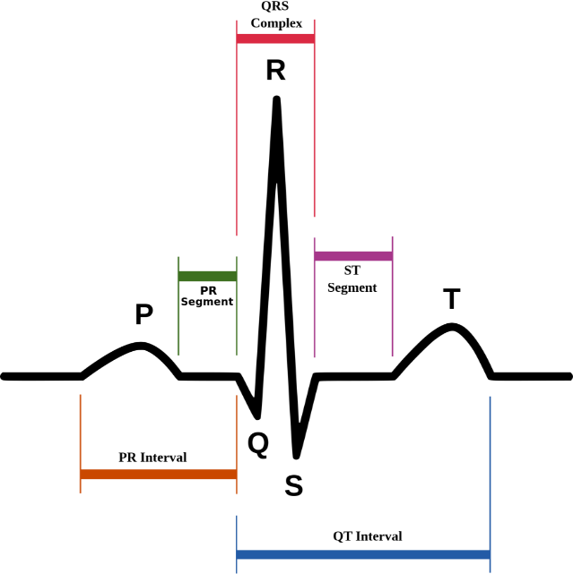
Simulation Input
Tetrahedral mesh segmented from CT of pig heart
Per node tensor field collected through DTI
Per node conductivity properties
Longitudinal and transmural conductivities
Ischemic zones user-selected
significantly less conductive than healthy tissue
Perform passive bidomain simulation
Simulates a single timestep during ST segment
Simulation Output
Per node voltage

Slide 6
Where’s the Uncertainty?
Tetrahedral mesh geometry
Tensor field
Conductivity properties
Ischemic zones (geometry & properties)

Slide 7
Conductivity Experiments
Physical experiments have led to an accepted range of conductivity properties, but true value remains unclear
We applied 2nd order generalized polynomial chaos-stochastic collocation [Xiu07] to longitudinal and transmural conductivities
This method produced a series of 41 distinct conductivity combinations

Slide 8
muView System
Visualization is “easy” if you know what features you’re looking for
Mentality: we don’t know what we’re looking for, if anything, so try everything
Software Design
quick prototyping for new techniques
design inspired by SCIRun
attempted to be modular, with APIs flexible to multiple input types, without over developing APIs

Slide 9
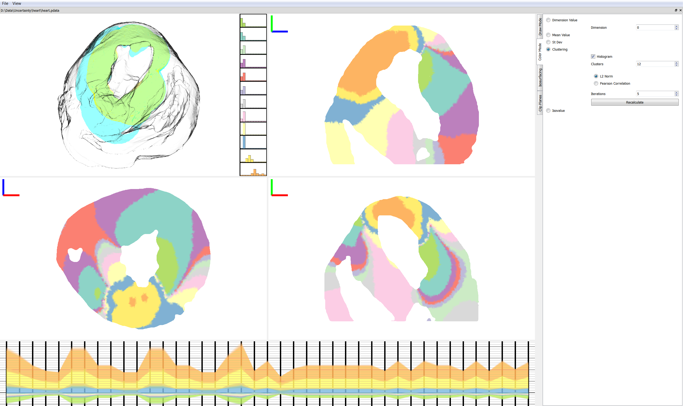
muView Visualization System
Notes:
Tetrahedral mesh segmented from CT of pig heart
Per node n-dimensional voltages

Slide 10
muView Visualization System

Slide 11
muView Visualization System

Slide 12
muView Visualization System

Slide 13
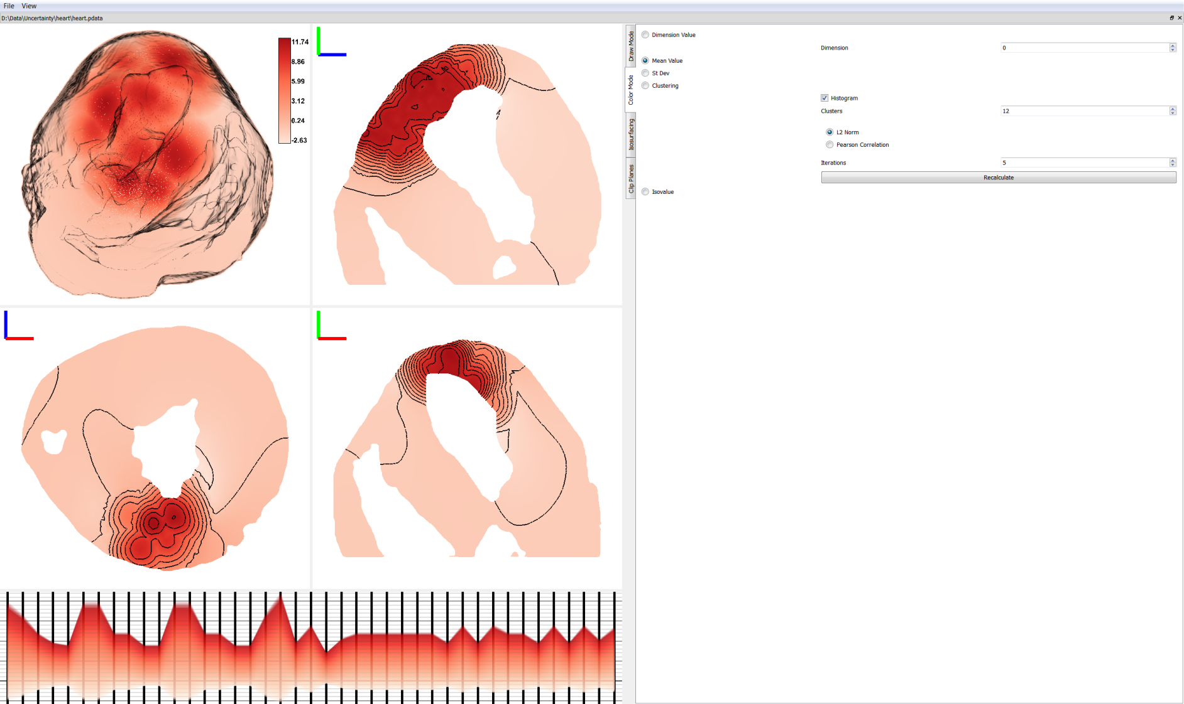
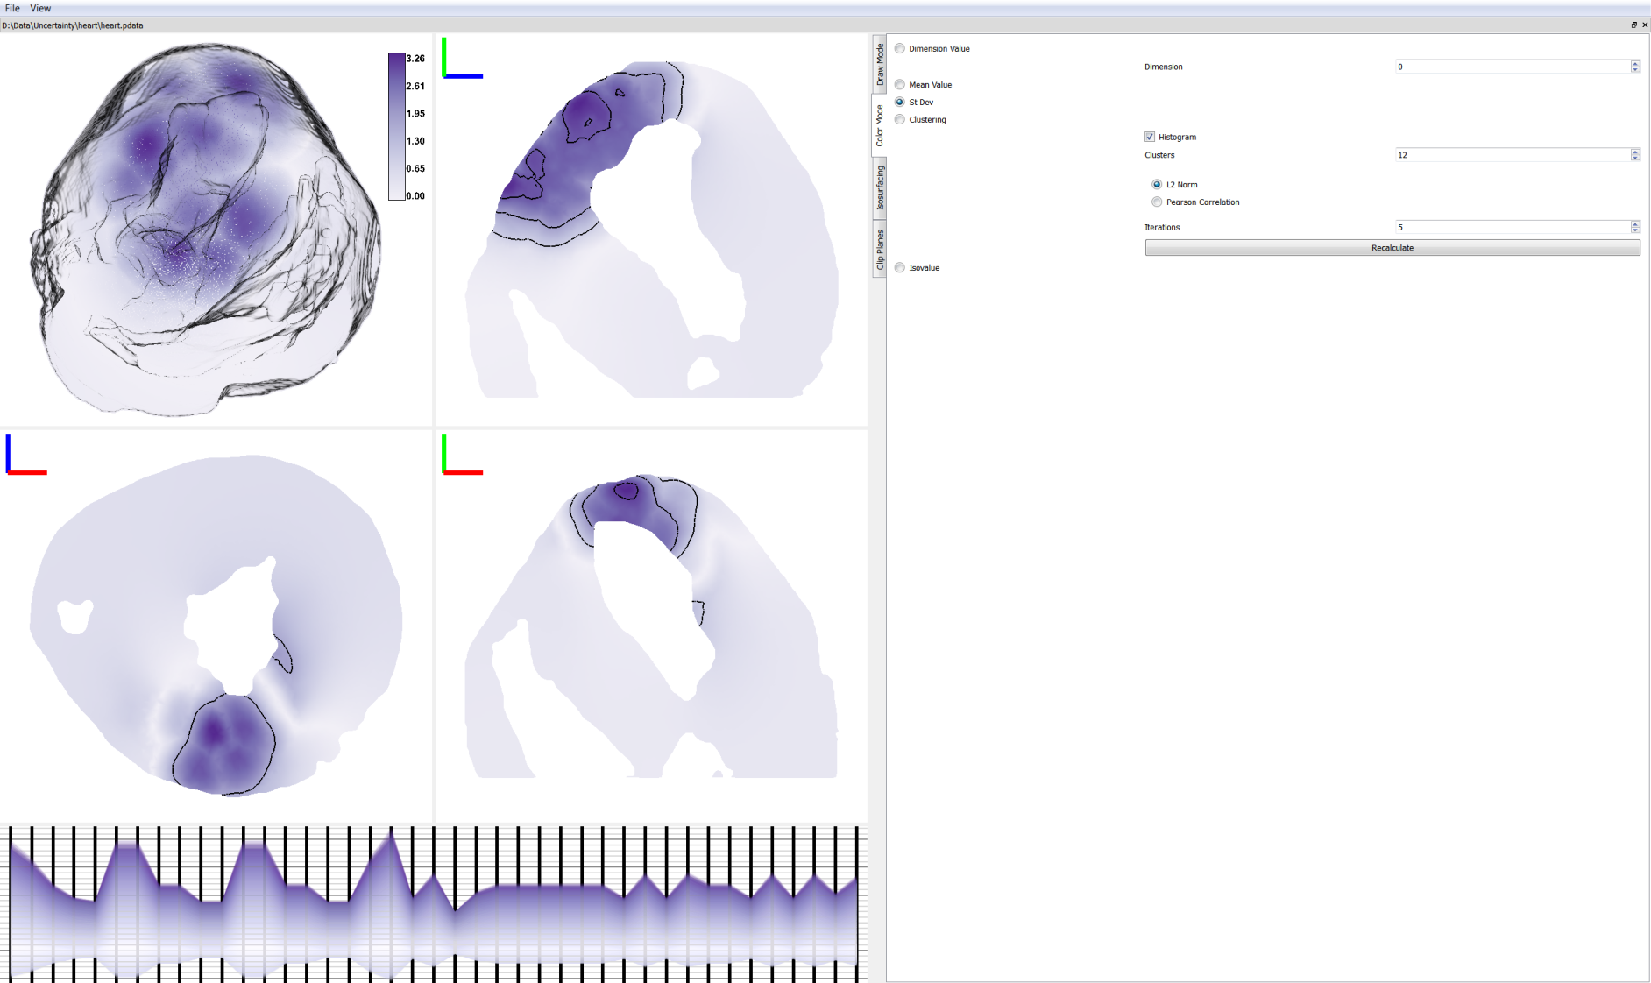
Mean and Standard Deviation
Mean
Standard Deviation

Slide 14
Mean and Standard Deviation
Mean
Standard Deviation

Slide 15
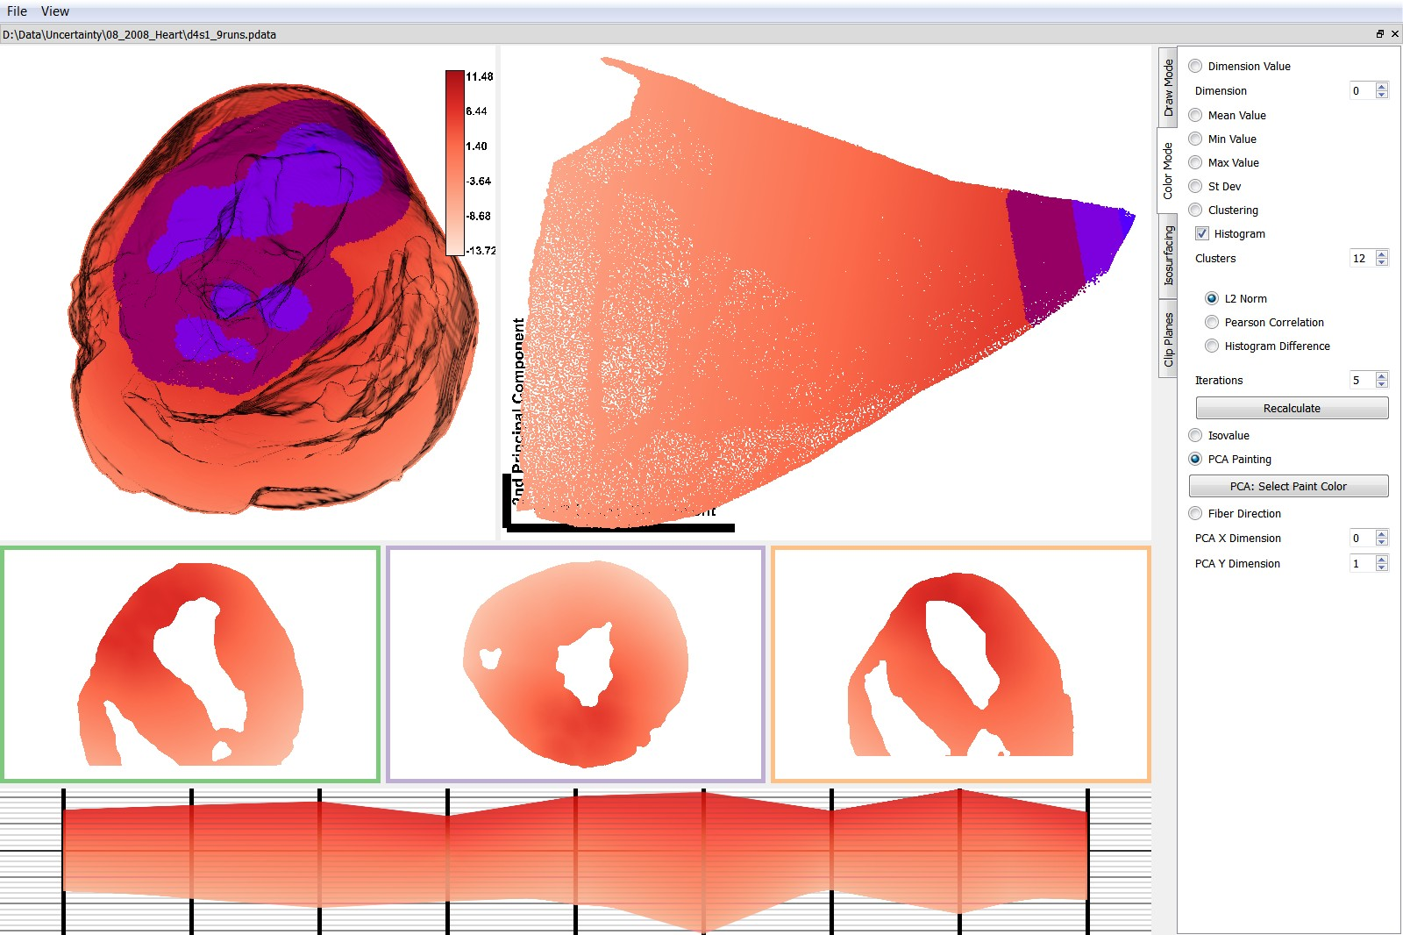
PCA View

Slide 16
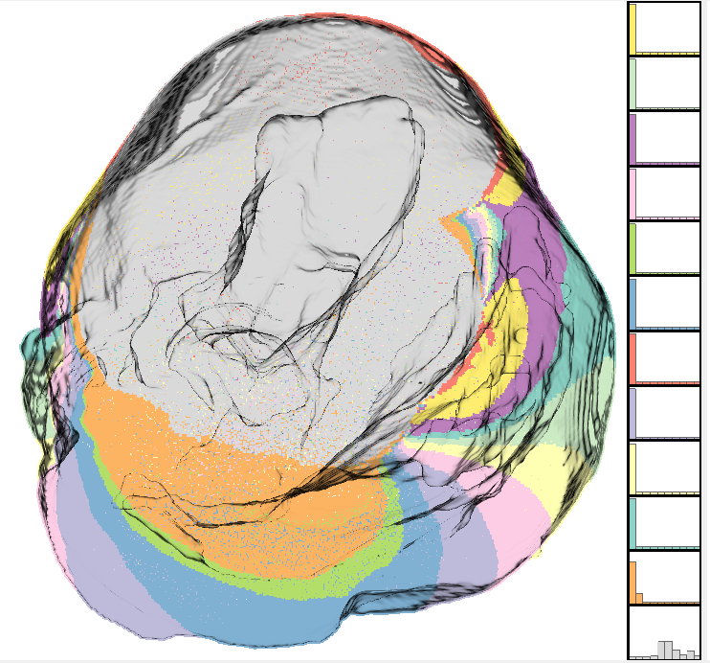
Clustering by k-means

Slide 17
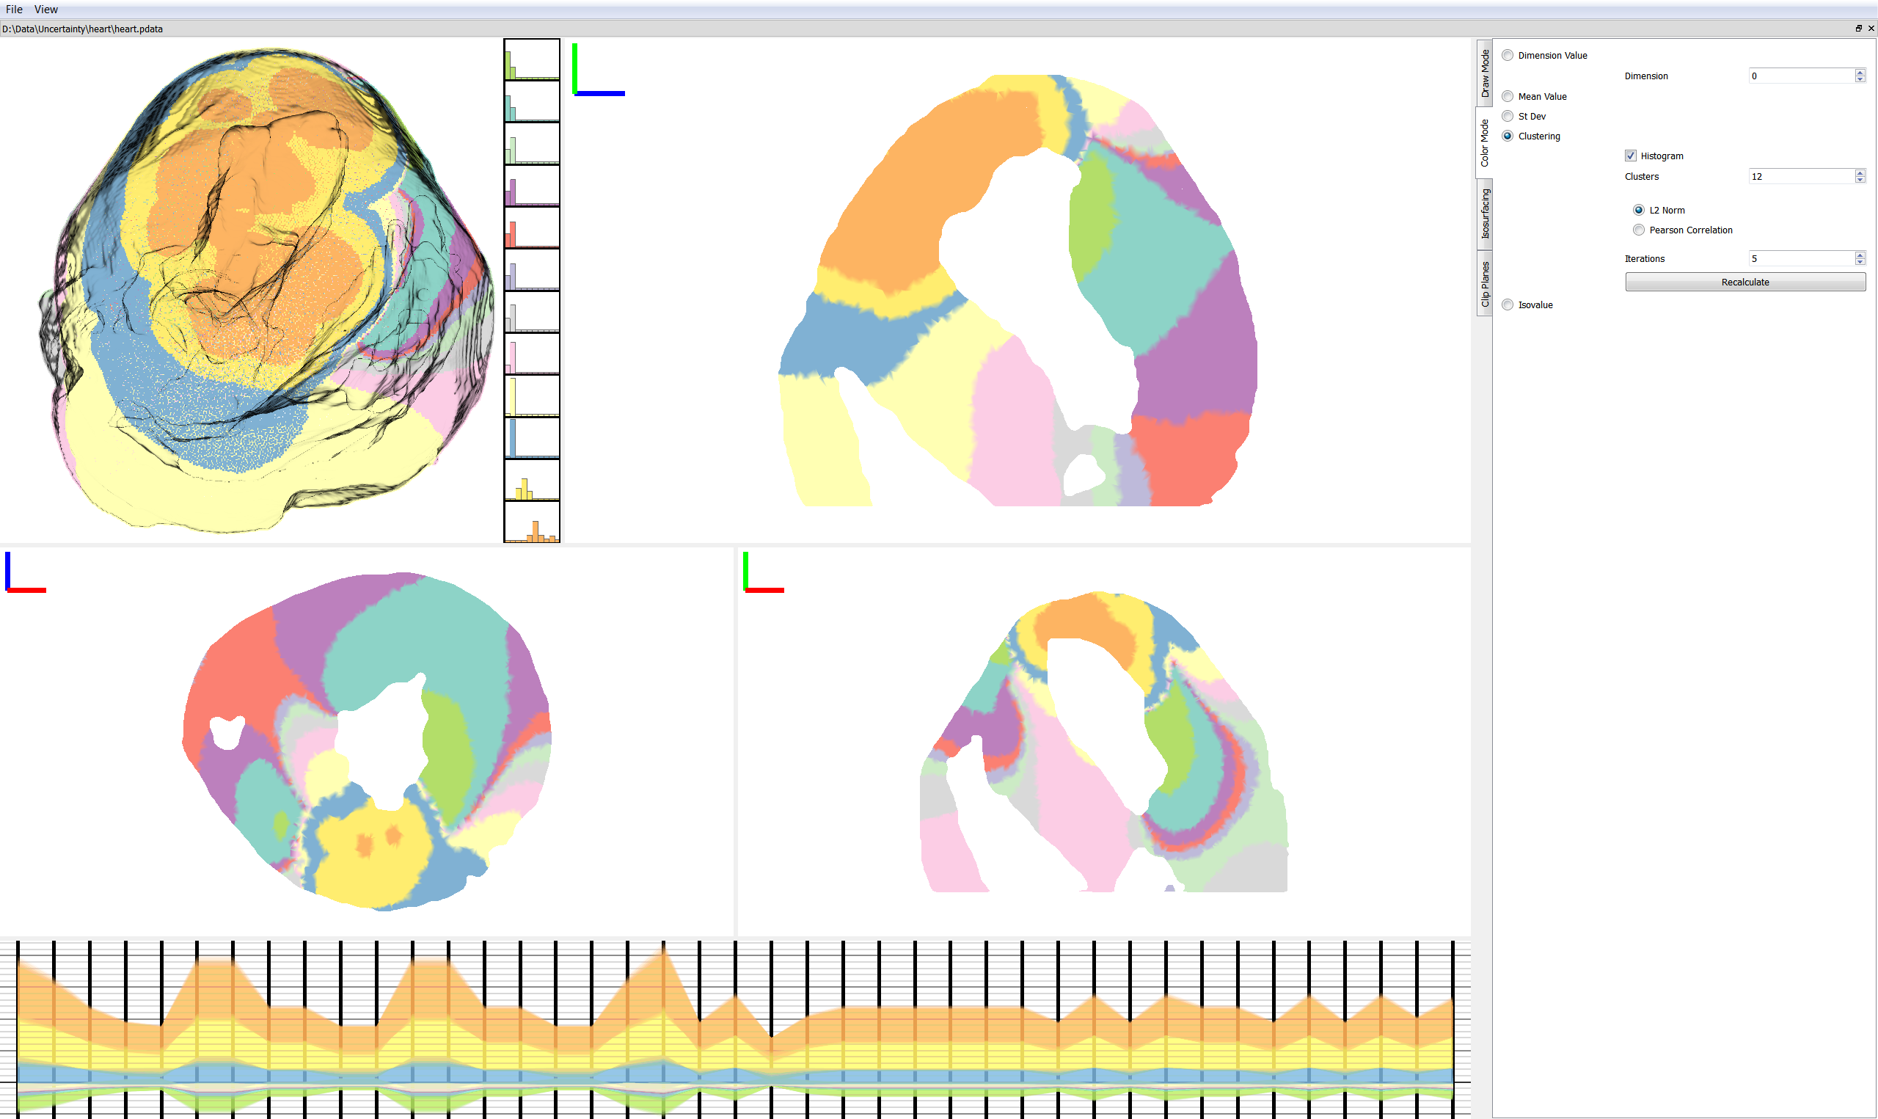


Clustering
L2-Norm Distance
Pearson’s Correlation

Slide 18
Clustering
L2-Norm Distance
Pearson’s Correlation

Slide 19
Isovalue Visualization
Uncertain data values means isosurface location is uncertain
Produce single scalar field – apply operator to each data point (i.e. minimum, maximum, mean, etc.)
Apply isosurfacing

Slide 20
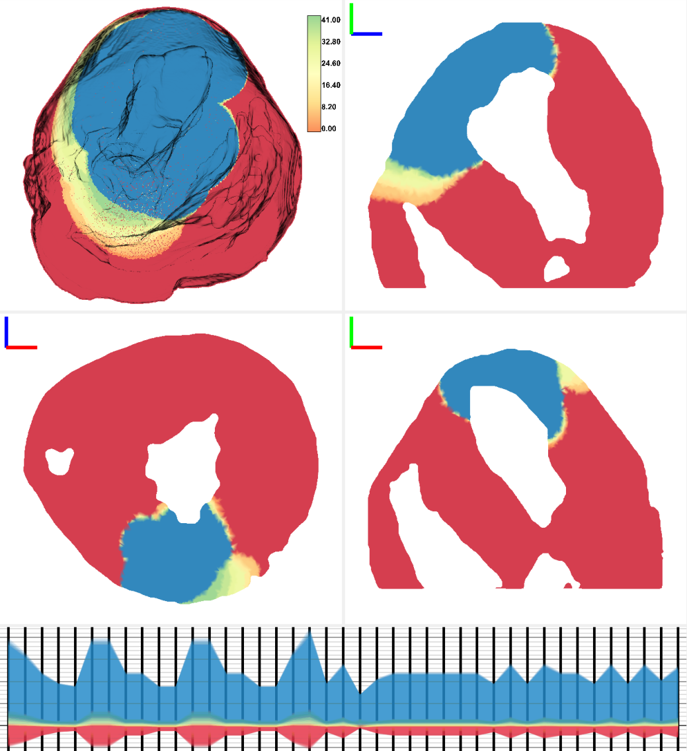
Isovalue Color Maps
Count values above or below isovalue
Color map indicates
Blue – all values above isovalue
Red – all values below isovalue
Orange to Green – ratio of values above isovalue

Slide 21
Isovalue Color Maps
Count values above or below isovalue
Color map indicates
Blue – all values above isovalue
Red – all values below isovalue
Orange to Green – ratio of values above isovalue

Slide 22
Results
Further investigation into the input data
Tensors (muscle fiber directions) were extremely noisy near the heart surface

Slide 23
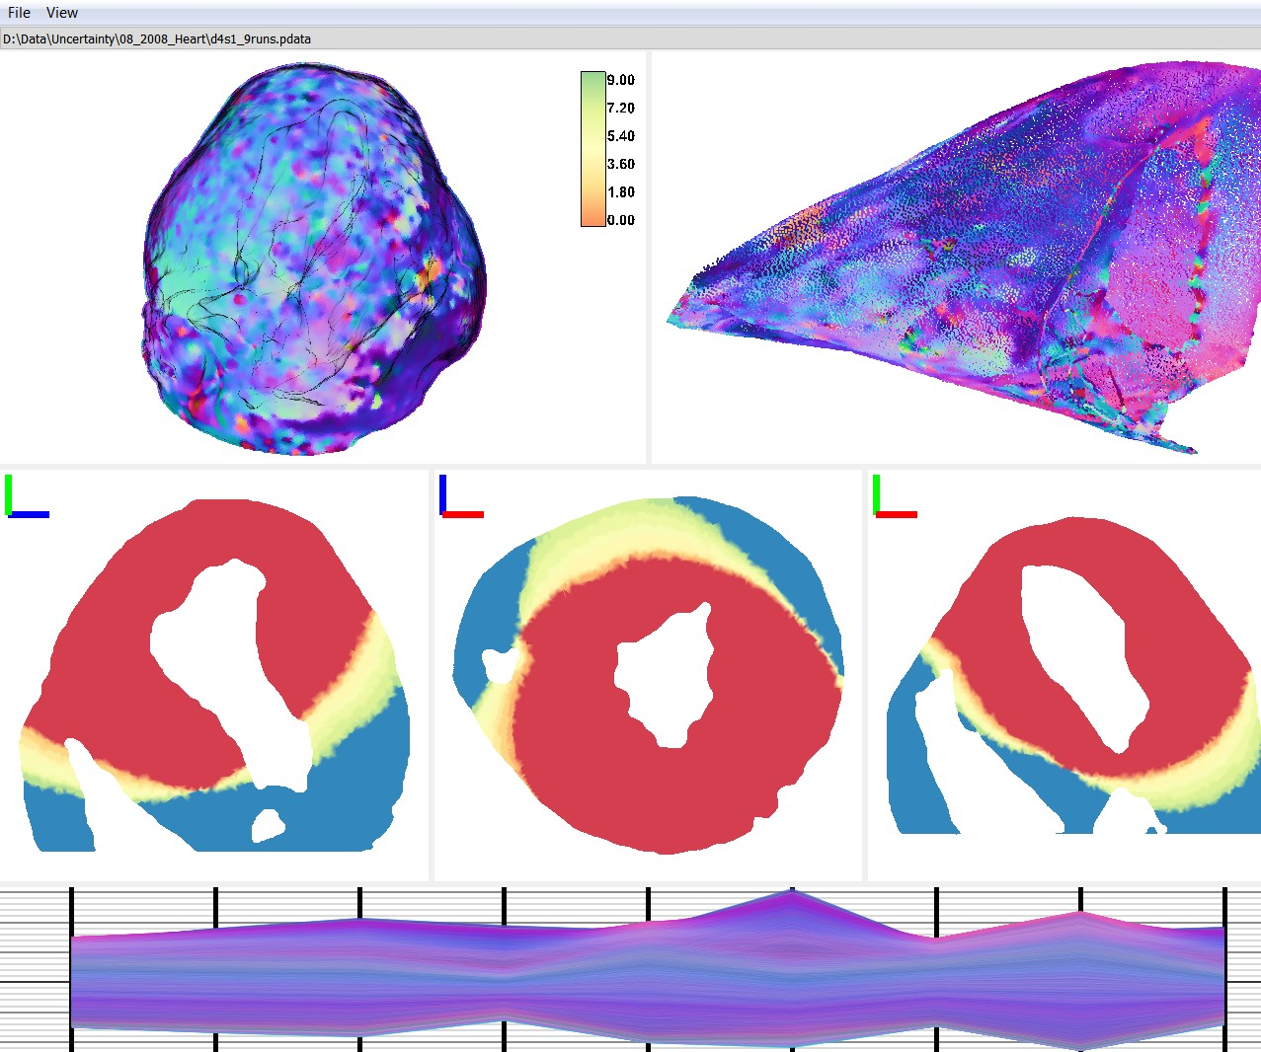
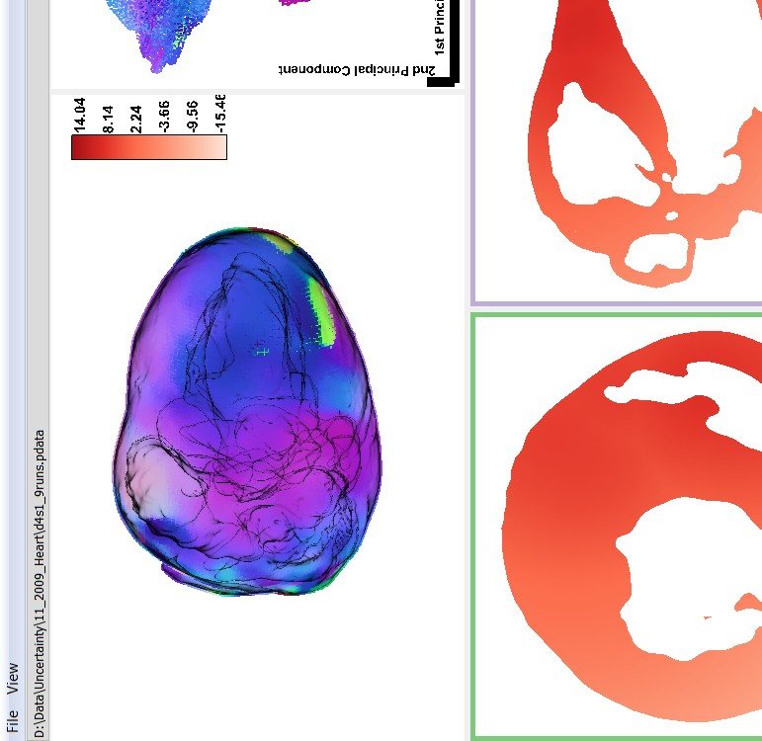
Color By Fiber Direction

Slide 24


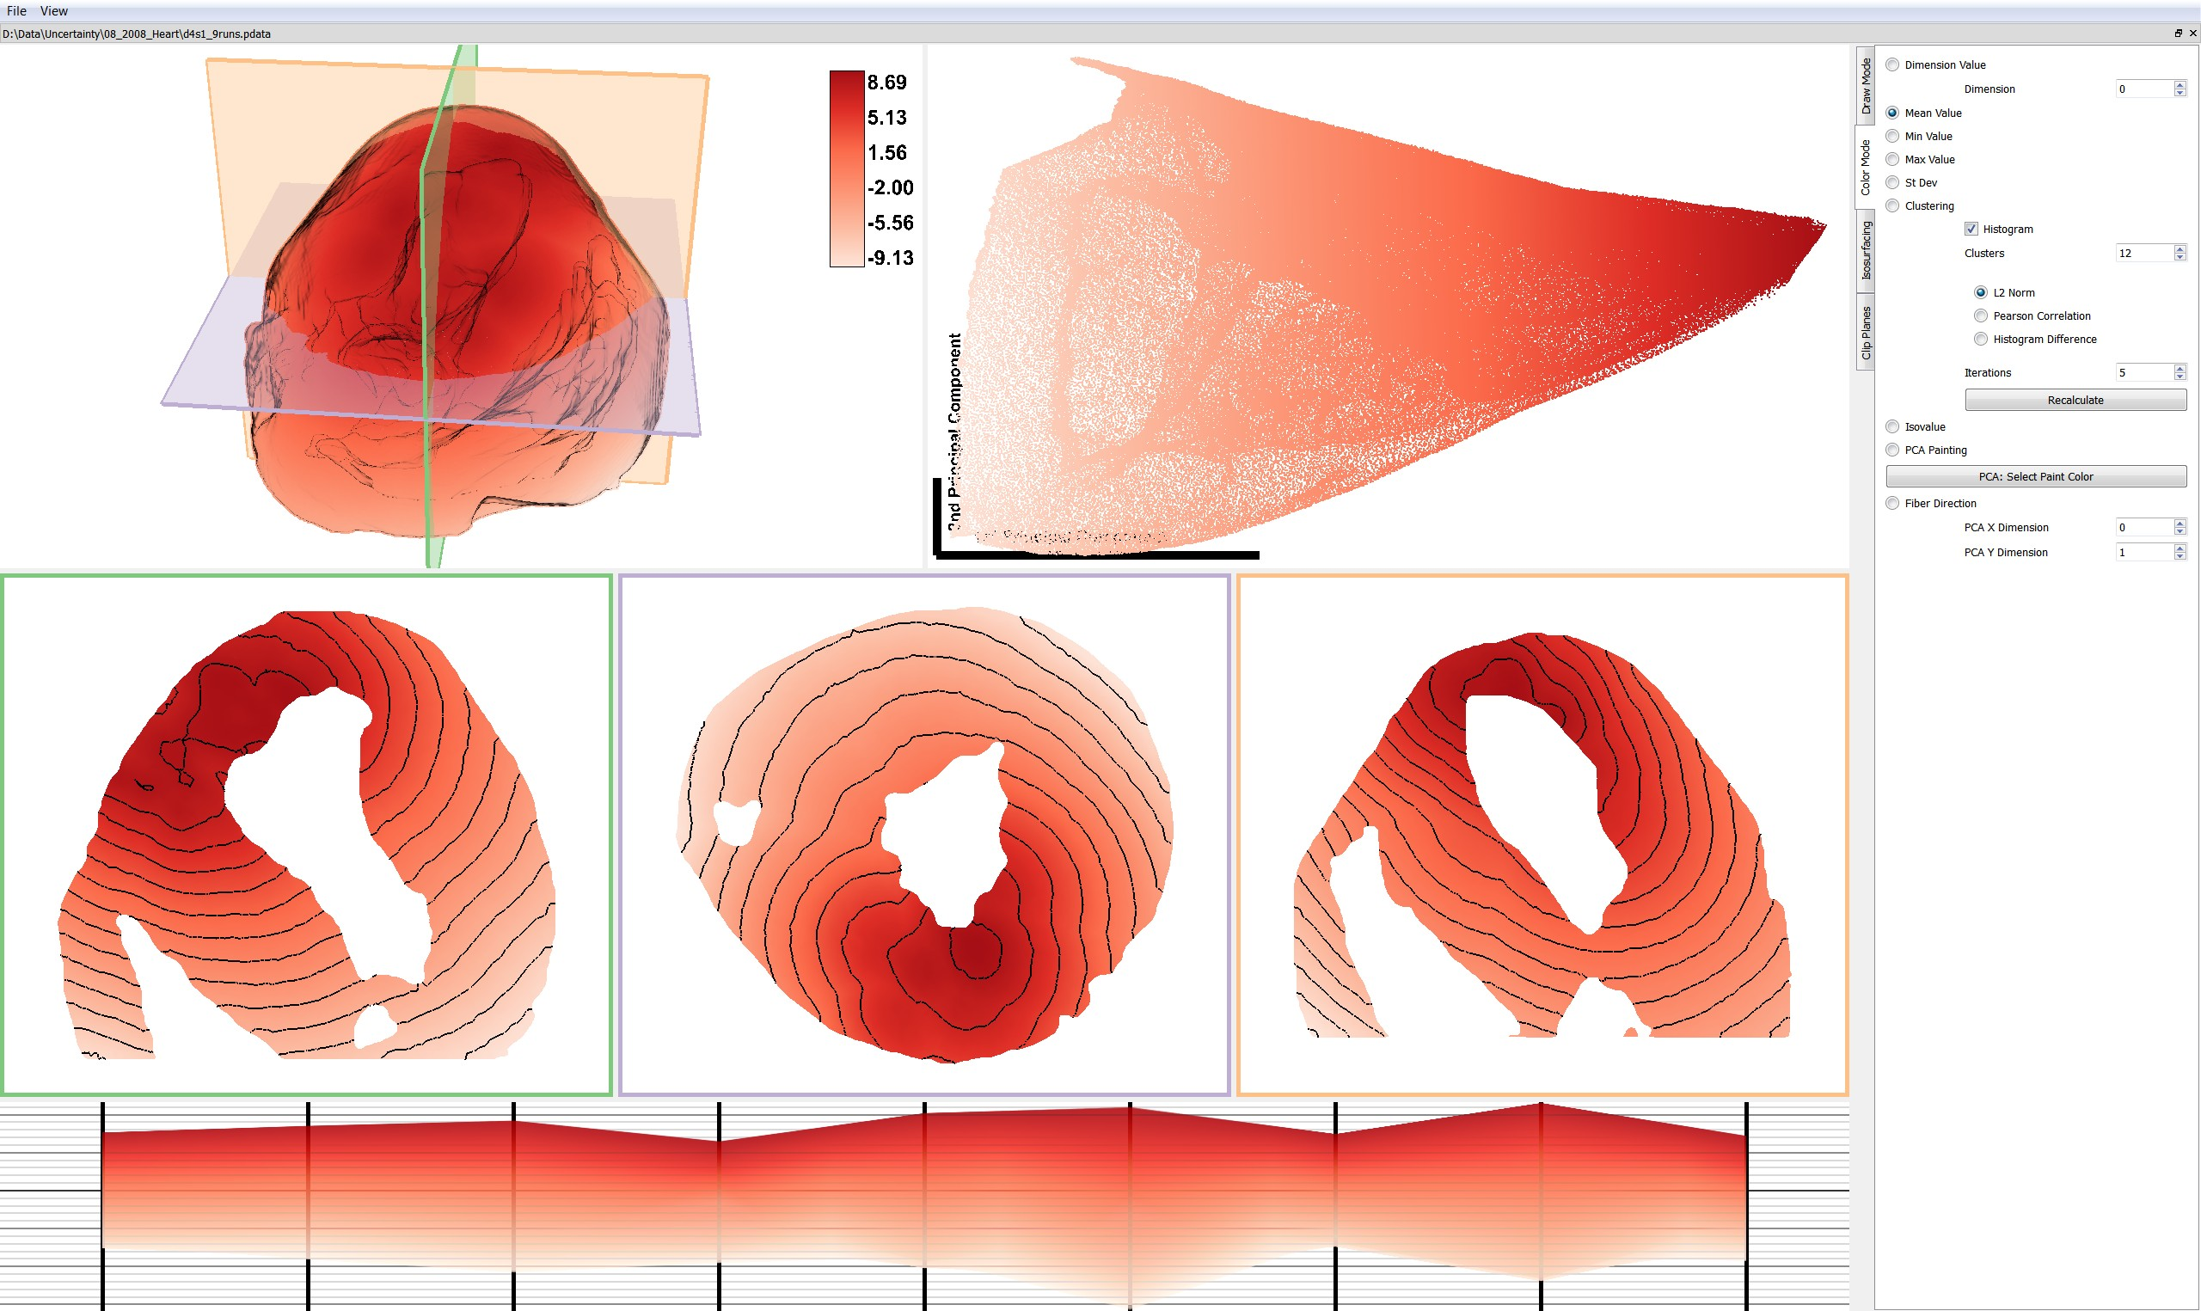
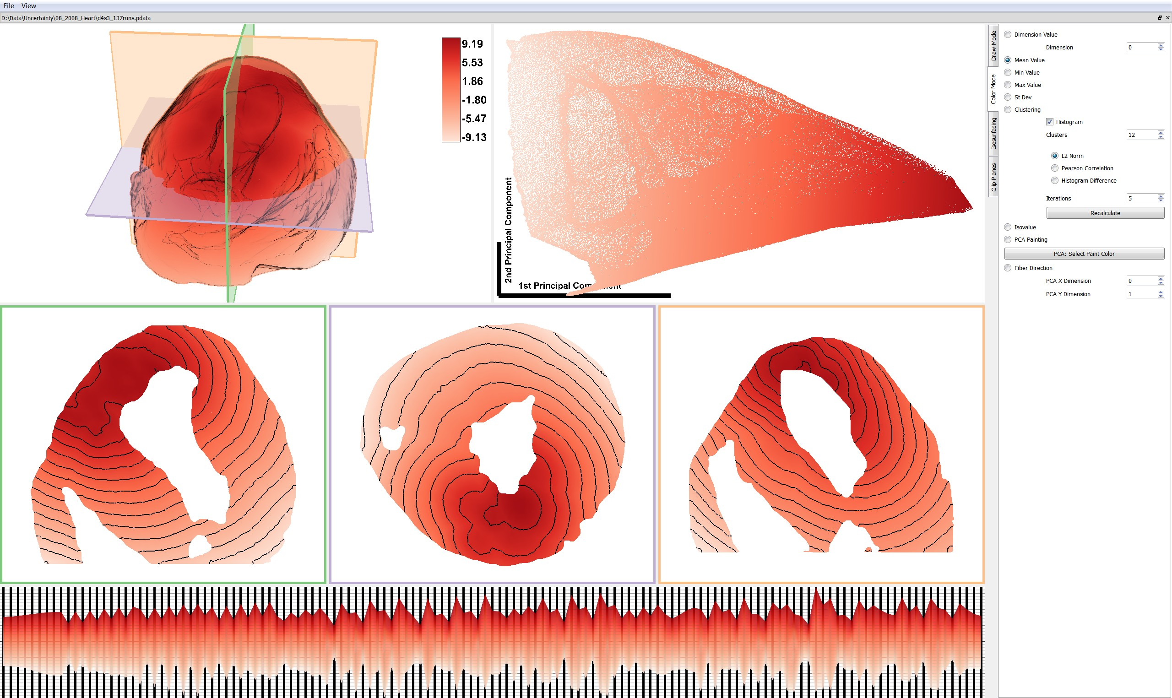
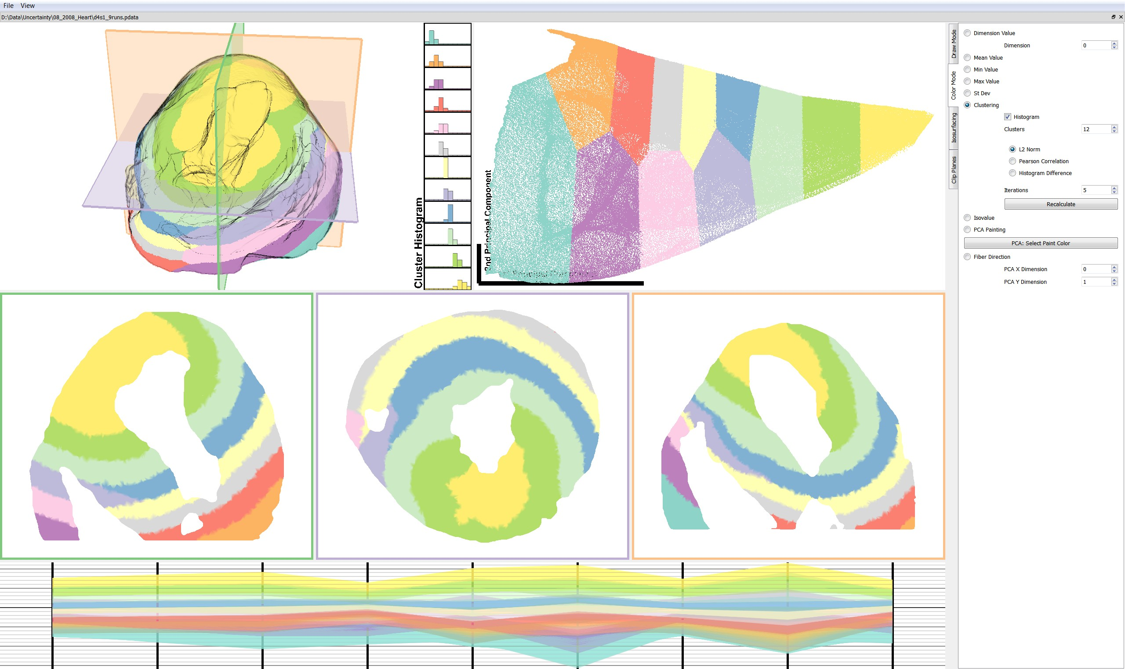
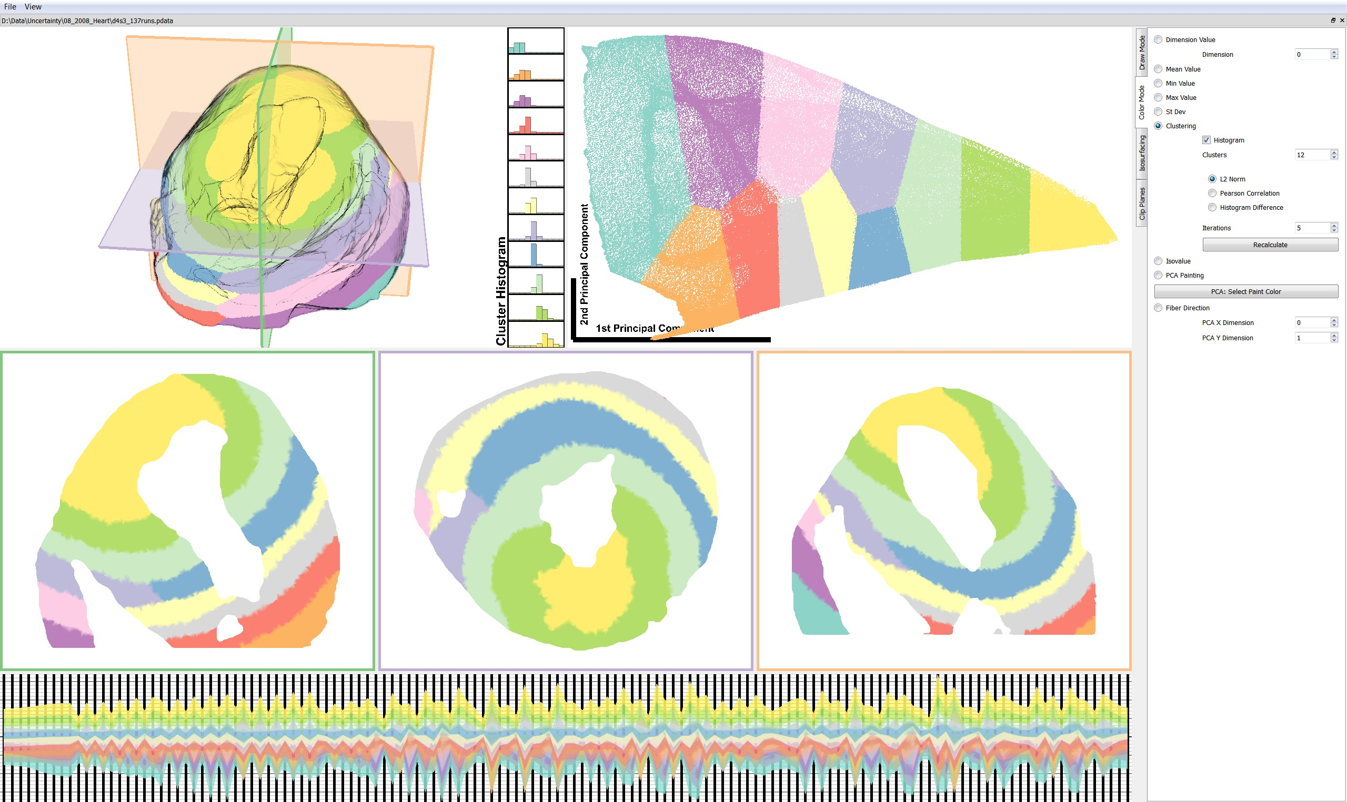
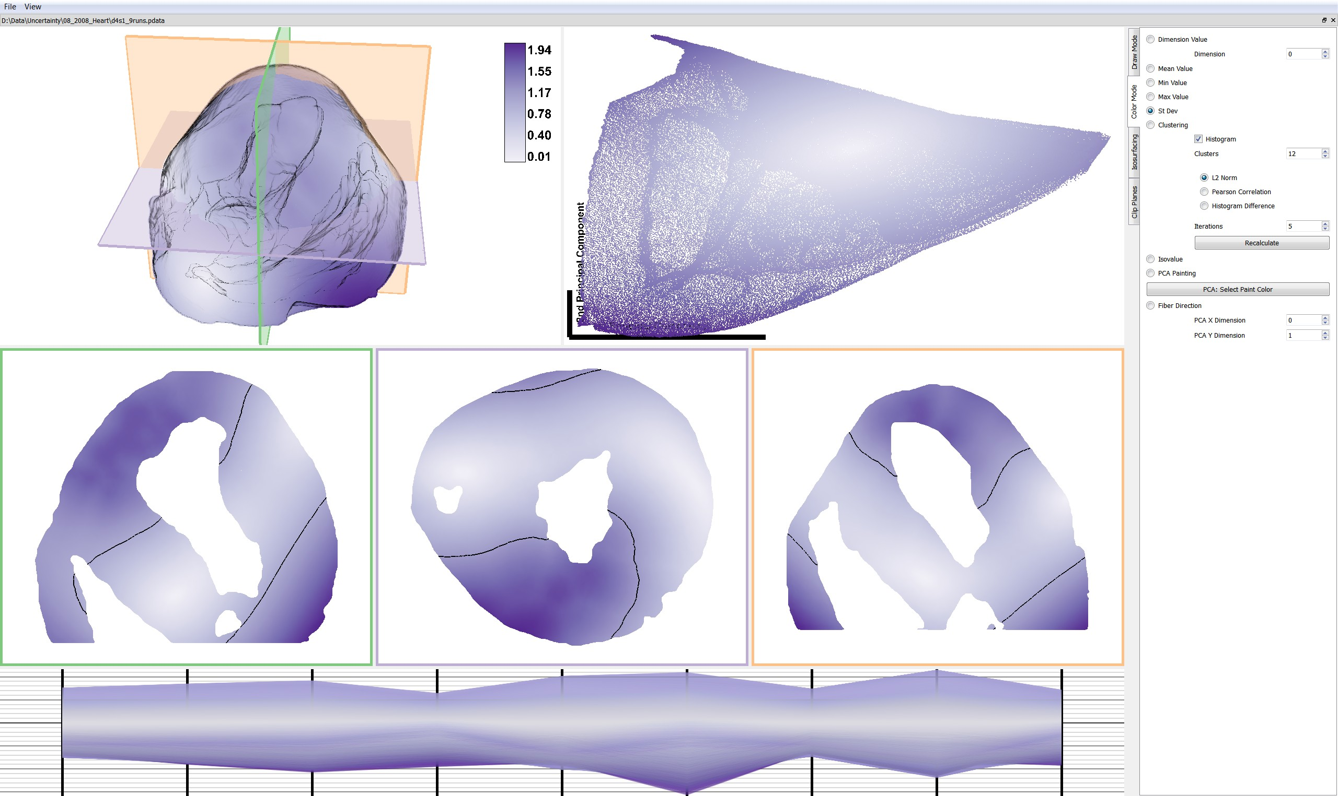
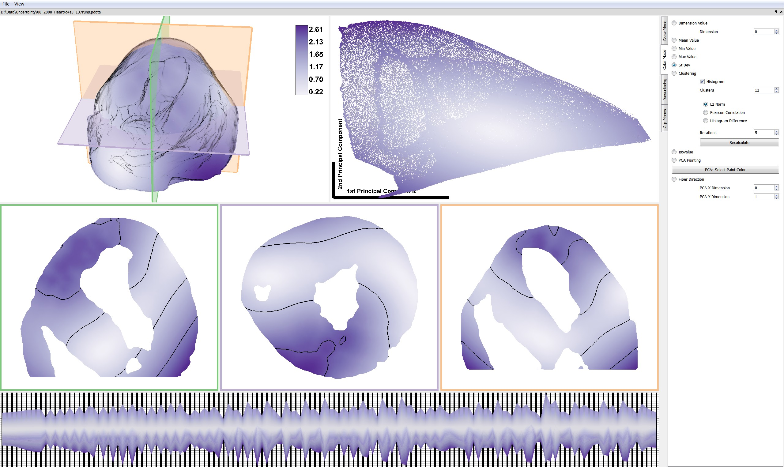
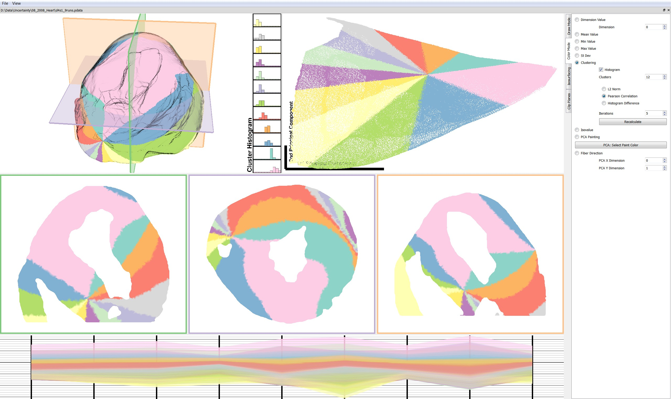
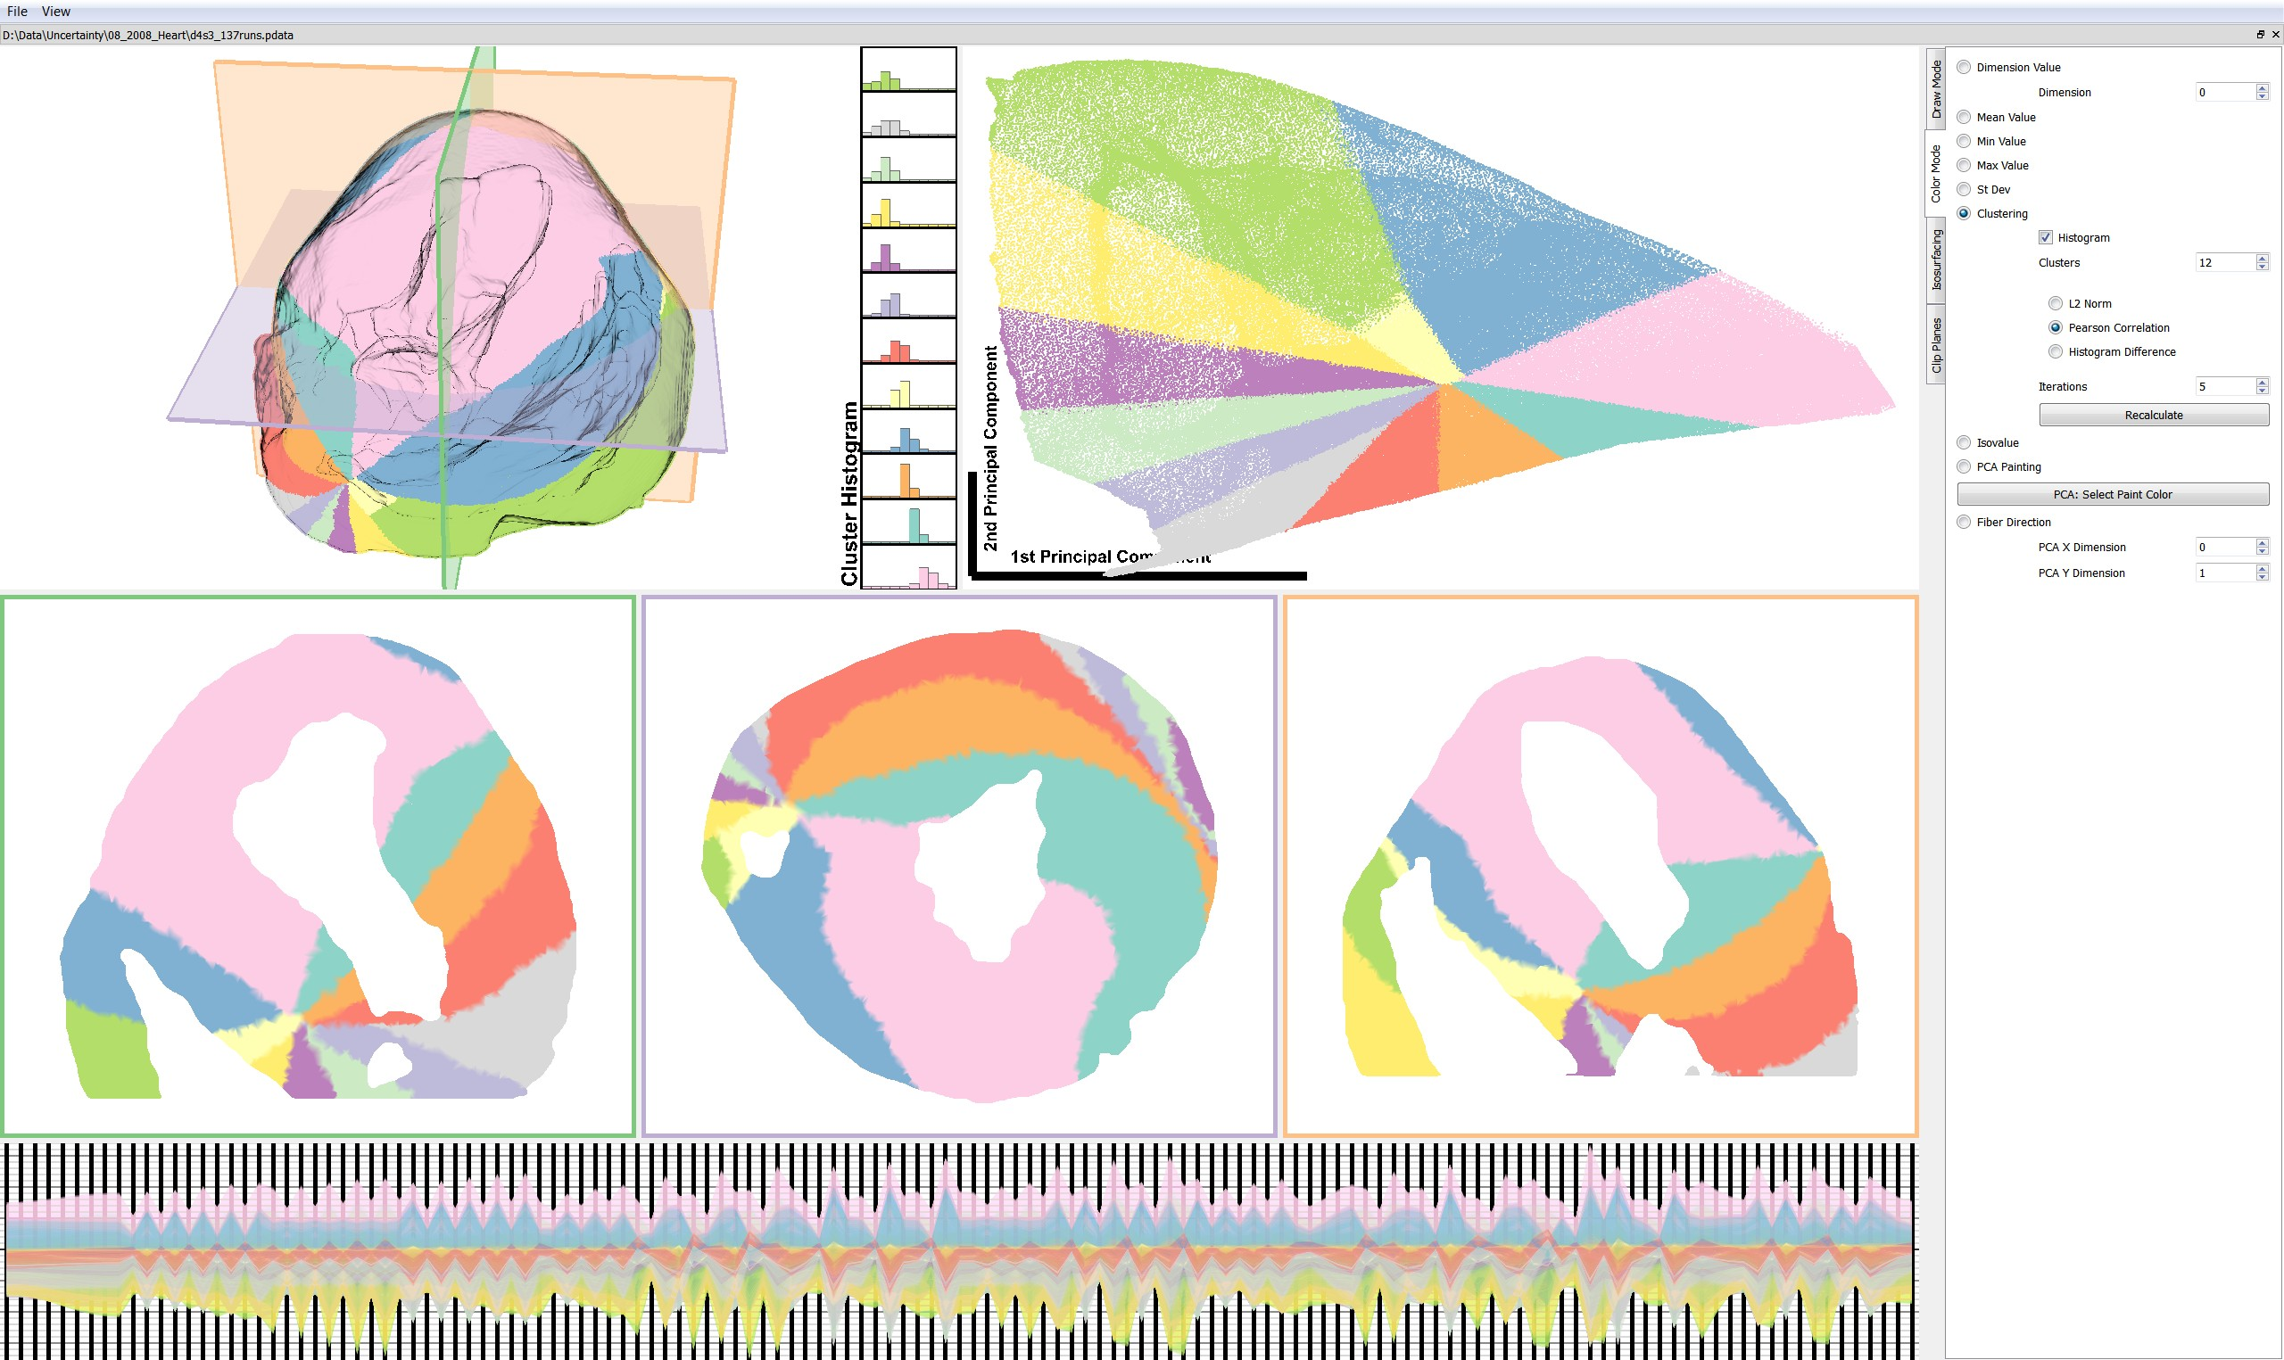
Comparing 1st & 3rd Order

Slide 25
Results
1st, 2nd, & 3rd order all produced similar results
Local variation is a weak signal relative to global offset

Slide 26
Visualizations
Mean and standard deviation – great place to start but risk leading to incomplete analysis
Clustering – interesting features that might be visible in other visualizations. PCC showed parameters were highly correlated
PCA View – extracted the signal and variation. The variation wasn’t that meaningful.
Fiber direction – common approach by limited utility for this problem
Isovalue visualizations – in our case has led to insight, but it represents a slow search space

Slide 27
Future Work: Where’s the Uncertainty?
Tetrahedral mesh geometry
Tensor field
Conductivity properties
Ischemic zones (geometry & properties)

Slide 28
Thank you
Questions?

